Slide 1

UECS3213 / UECS3453 Data Mining Topic 3b: Classification (Part 2) Naive Bayes, Support Vector Machine (SVM), Ensemble Methods
Dr. Simon Lau Boung Yew

Slide 2
Course Learning Outcomes
CO1: Identify the key technological foundations of data mining
CO2: Create programming solutions using data mining techniques for given problem
CO3: Evaluate performance of data mining solutions for a given problem
CO4: Construct a data mining project as a team
CO5: Recognize the importance of data mining techniques and its applications in the industry

Slide 3
Outline
Part 1:
K-Nearest Neighbours
Decision Tree Classifier
Part 2:
Naïve Bayes Classifiers
Support Vector Machine (SVM)
Ensemble Methods
Part 3: Classification Performance
Confusion Matrix
Model Evaluation Methods
Receiver Operating Characteristic (ROC) Curve

Slide 4
Outline
Naive Bayes Classifier
Bayes Classifiers
Bayes Theorem
The Naïve Bayes Model
Examples
Strength
Weakness
Support Vector Machine
Definition
Discriminative vs Generative Classifiers
Examples
Linear SVM
Non-linear SVM
Strength
Weakness

Slide 5
Outline
Ensemble Methods
Definition
Examples
Types of Ensemble Methods
Bagging
Boosting
Random Forest

Slide 6
Bayes Classifiers

Slide 7
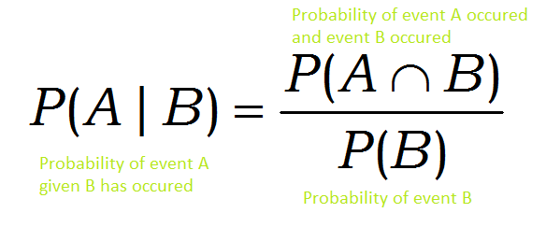
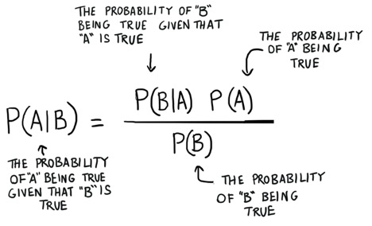
Bayes Classifier
A probabilistic framework for solving classification problems
Conditional Probability:
Bayes theorem:
Notes:
https://www.mathsisfun.com/data/probability-events-conditional.html

Slide 8
Probability Basics

Slide 9
Conditional Probability
P(A) means "Probability Of Event A"
P(B|A) means "Probability Of Event B given Event A"
P(B|A) is also called the "Conditional Probability" of B given A.
P(B|A) = 1/4
Notes:
https://www.mathsisfun.com/data/probability-events-conditional.html
https://www.mathgoodies.com/lessons/vol6/conditional

Slide 10
Example: Drawing 2 Kings from a Deck

Slide 11
Conditional Probability

Slide 12
Example: Ice Cream

Slide 13
Bayes Theorem
Bayes’ Theorem finds the probability of an event occurring given the probability of another event that has already occurred.
Bayes’ theorem is stated mathematically as the following equation:
Basically, we are trying to find probability of event A, given the event B (evidence) is true.
P(A) is the priori of A (the prior probability, i.e. Probability of event before evidence is seen). The evidence is an attribute value of an unknown instance(here, it is event B).
P(A|B) is a posteriori probability of B, i.e. probability of event after evidence is seen.

Slide 14
Bayes Theorem Example
Given:
A doctor knows that meningitis causes stiff neck 50% of the time, P(S|M) = 0.5
Prior probability of any patient having meningitis, P(M) = 1/50,000
Prior probability of any patient having stiff neck, P(S) = 1/20
If a patient has stiff neck, what’s the probability he/she has meningitis?

Slide 15
Bayesian Classifiers
Given a record with features / attributes (X₁, X₂,…,X_{n})
Consider each attribute, A and class label, C as random variables
Goal is to predict class C
Specifically, we want to find the value of C that maximizes P(C| X₁, X₂,…,X_{n} )
Can we estimate P(C| X₁, X₂,…,X_{n} ) directly from data?

Slide 16
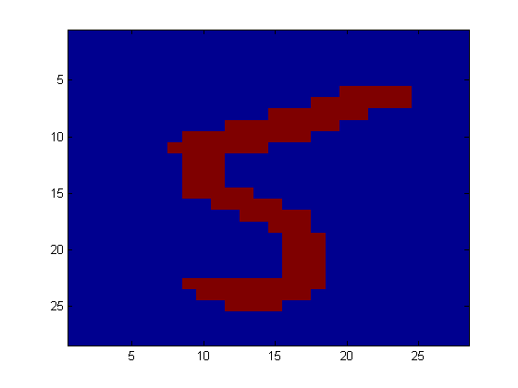
Example Application: Digit Recognition
Feature set: X₁,…,X_{n} ∈ {0,1} (Black vs. White pixels)
Class: Y ∈ {5,6} (predict whether a digit is a 5 or a 6)
Classifier
5

Slide 17
Bayesian Classifiers Approach
Compute the posterior probability P(C | X₁, X₂, …, X_{n}) for all values of C using the Bayes theorem
Choose value of C (from a set of possible values) that maximizes P(C | X₁, X₂, …, X_{n})
the higher the conditional probability is, the higher chance it is a ‘C’.
Equivalent to choosing value of C that maximizes
P(X₁, X₂, …, X_{n}|C) P(C)
Question: How to estimate P(X₁, X₂, …, X_{n} | C )?

Slide 18
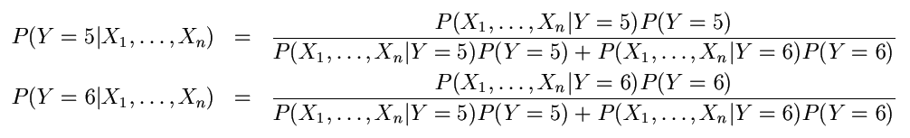
Example Application: Digit Recognition
What is the probability that the image represents a 5 given its pixels?
So … How do we compute that? Use Bayes Theorem!
To classify, we’ll compute these two probabilities and predict based on which one is greater

Slide 19
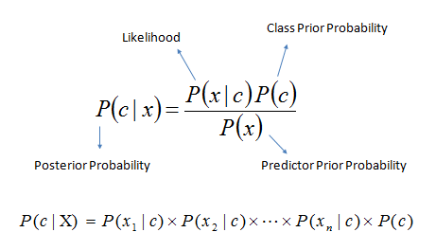
Model Parameters
For the Bayes classifier, we need to “learn” two functions, the likelihood and the prior
How many parameters are required to specify the prior for our digit recognition example?
How many parameters are required to specify the likelihood?

Slide 20
Model Parameters
The problem with explicitly modeling P(X₁,…,X_{n}|Y) is that there are usually way too many parameters:
We will run out of space
We will run out of time
And we will need a lot of training data (which is usually not available)

Slide 21
Naive Bayes Classifiers

Slide 22
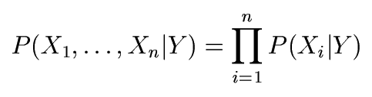
The Naïve Bayes Model
The fundamental Naive Bayes assumption is that each feature makes an independent and equal contribution to the outcome. (We will discuss the validity of this assumption later)
Naïve Bayes Assumption: Assume that all features are independent given the class label Y:
It means
P(X₁, ..., X_{n} | Y) = P(X₁ | Y) P(X₂ | Y) ... P(X_{n} |Y) (product of the conditional probability of each feature separately)

Slide 23
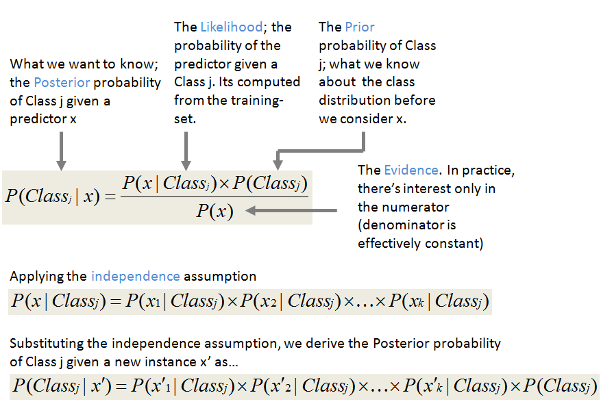
The Naïve Bayes Model

Slide 24
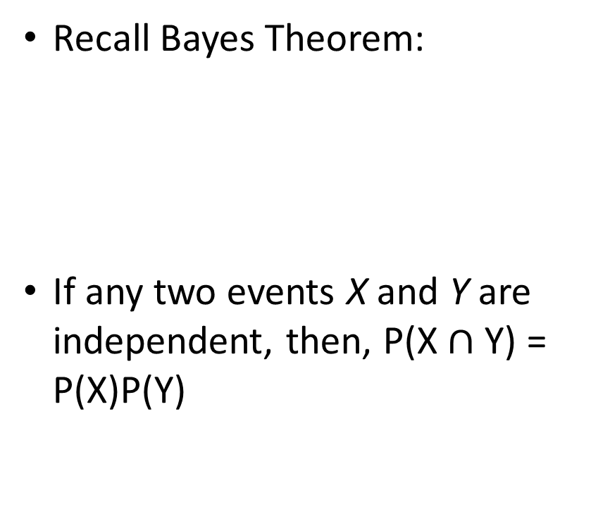
Naive Bayes Classifiers
Recall Bayes Theorem:
If any two events X and Y are independent, then, P(X $∩$Y) = P(X)P(Y)

Slide 25
How to estimate probabilities from discrete attribute data?
Tid | Refund | Marital Status | Taxable Income | Evade
1 | Yes | Single | 125K | No
2 | No | Married | 100K | No
3 | No | Single | 70K | No
4 | Yes | Married | 120K | No
5 | No | Divorced | 95K | Yes
6 | No | Married | 60K | No
7 | Yes | Divorced | 220K | No
8 | No | Single | 85K | Yes
9 | No | Married | 75K | No
10 | No | Single | 90K | Yes

Slide 26
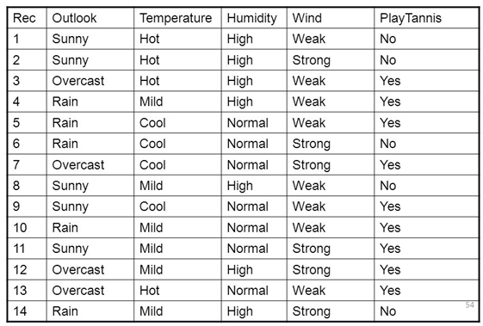
Example 1: Weather Data Example
feature matrix, X
response vector, Y
Consider a fictional dataset that describes the weather conditions for playing a game of golf.
Given the weather conditions, each tuple classifies the conditions as fit(“Yes”) or unfit(“No”) for playing golf.

Slide 27
Weather Data Example
The dataset is divided into two parts:
feature matrix and the response vector.
Feature matrix contains all the vectors (rows) of dataset in which each vector consists of the value of dependent features.
In above dataset, features are ‘Outlook’, ‘Temperature’, ‘Humidity’ and ‘Windy’.
Response vector contains the value of class variable (prediction or output) for each row of feature matrix.
In above dataset, the class variable name is ‘Play golf’.

Slide 28
Wearther Data Example
We assume that no pair of features are dependent (naïve).
For example, the temperature being ‘Hot’ has nothing to do with the humidity or the outlook being ‘Rainy’ has no effect on the winds.
Hence, the features are assumed to be independent.
Secondly, each feature is given the same weight (or importance).
For example, knowing only temperature and humidity alone can’t predict the outcome accurately.
None of the attributes is irrelevant and assumed to be contributing equally to the outcome.
Note: The assumptions made by Naive Bayes are not generally correct in real-world situations but often works well in practice.

Slide 29
Weather Data Example

Slide 30
Weather Data Example: Learning Phase, Construct Classifier
Let us try to apply the above formula on our weather dataset.
For this, We need to find
P(x_{i} | y_{j}) for each x_{i} in X and y_{j} in y.

Slide 31
Weather Data Example: Learning Phase, Construct Classifier
In the previous slide, we have calculated P(x_{i} | y_{j}) for each x_{i} in X (outlook, temperature, humidity, wind) and y_{j} in y (“yes” or “no”) manually.
For example,
Conditional probability of playing golf given that the temperature is cool, i.e P(temp = cool | play golf = Yes) = 3/9.
Priori, P(play golf = Yes) = 9/14.
We are done with our pre-computations (training) and the classifier is ready!

Slide 32
Weather Data Example: Test Data
Let us test it on a new set of features (for today):
today = (Outlook: Sunny, Temp: Hot, Humidity: Normal, Wind: Weak)
So, probability of playing golf (Yes) is:
Probability to not play golf (No) is

Slide 33
Weather Data Example: Test Data 1
Since, P(today) is common in both probabilities, we can ignore P(today) and find proportional probabilities as:

Slide 34
Weather Data Example: Test Data 2
Given a new instance, predict its label
x’=(Outlook=Sunny, Temperature=Cool, Humidity=High, Wind=Strong)
Look up tables achieved in the learning phrase
Decision making
P(Outlook=Sunny|Play=Yes) = 2/9
P(Temperature=Cool|Play=Yes) = 3/9
P(Huminity=High|Play=Yes) = 3/9
P(Wind=Strong|Play=Yes) = 3/9
P(Play=Yes) = 9/14
P(Outlook=Sunny|Play=No) = 3/5
P(Temperature=Cool|Play==No) = 1/5
P(Huminity=High|Play=No) = 4/5
P(Wind=Strong|Play=No) = 3/5
P(Play=No) = 5/14
P(Yes|x’) ≈ [P(Sunny|Yes)P(Cool|Yes)P(High|Yes)P(Strong|Yes)]P(Play=Yes) = 0.0053
P(No|x’) ≈ [P(Sunny|No) P(Cool|No)P(High|No)P(Strong|No)]P(Play=No) = 0.0206
Given the fact P(Yes|x’) < P(No|x’), we label x’ to be “No”.

Slide 35
How to estimate probabilities from continuous attribute data?
In case of continuous data, we need to make some assumptions regarding the distribution of values of each feature.
Discretize the range into bins
one ordinal attribute per bin (range)
violates independence assumption
Two-way split:(A < v) or (A ≥ v)
choose only one of the two splits as new attribute
Probability density estimation:
Assume attribute follows a normal distribution
Use data to estimate parameters of distribution (e.g., mean and standard deviation)
Once probability distribution is known, can use it to estimate the conditional probability P(A_{i}|c)
The different naive Bayes classifiers differ mainly by the assumptions they make regarding the distribution of P(x_{i} | y).

Slide 36
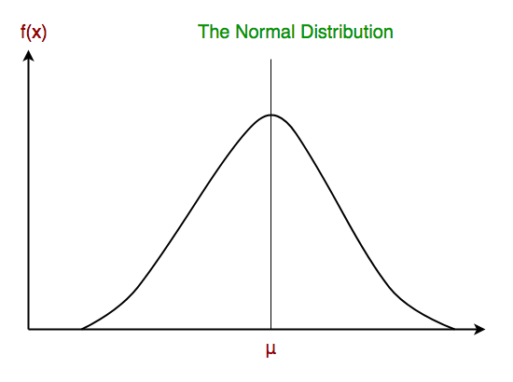
Gaussian Naive Bayes classifier
In Gaussian (Normal) Naive Bayes, continuous values associated with each feature are assumed to be distributed according to a Gaussian distribution.

Slide 37
Example 2: How to estimate probabilities from continuous attribute data?
Tid | Refund | Marital Status | Taxable Income | Evade
1 | Yes | Single | 125K | No
2 | No | Married | 100K | No
3 | No | Single | 70K | No
4 | Yes | Married | 120K | No
5 | No | Divorced | 95K | Yes
6 | No | Married | 60K | No
7 | Yes | Divorced | 220K | No
8 | No | Single | 85K | Yes
9 | No | Married | 75K | No
10 | No | Single | 90K | Yes

Slide 38
Example 2: of Naive Bayes Classifier

Slide 39
Weather Example: Continuous-valued Features
Temperature is naturally of continuous value.
Yes: 25.2, 19.3, 18.5, 21.7, 20.1, 24.3, 22.8, 23.1, 19.8
No: 27.3, 30.1, 17.4, 29.5, 15.1
Estimate mean and variance for each class
Learning Phase: output two Gaussian models for P(temp|C)

Slide 40
Example 3: of Naive Bayes Classifier

Slide 41
Strength
Simple, fast, and very effective
Does well with noisy and missing data (resilient to noise)
Requires relatively few examples for training, but also works well with very large numbers of examples
Easy to obtain the estimated probability for a prediction

Slide 42
Weakness
Relies on an often-faulty assumption of equally important and independent features

Slide 43
Conclusion (Naive Bayes)
Naïve Bayes is
easy to implement and often works well
equally important and independent features assumptions
often a good first thing to try → commonly used as a “punching bag” for smarter algorithms

Slide 44
Support Vector Machine (SVM)

Slide 45
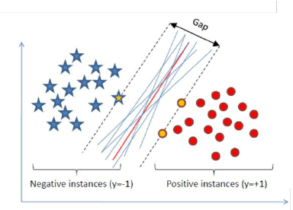
Support Vector Machine
A Support Vector Machine (SVM) is a discriminative classifier formally defined by a separating hyperplane.
In other words, given labeled training data (supervised learning), the algorithm outputs an optimal hyperplane which categorizes new examples.
An SVM model is a representation of the examples as points in space, mapped so that the examples of the separate categories are divided by a clear gap that is as wide as possible.

Slide 46
Discriminative vs Generative Classifiers
Generative classifier tries to learn the model that generates the (training) data behind the scenes by explicitly models the actual distribution of each class (probabilistic).
It then uses this to predict unseen (test) data, because it assumes the model that was learned captures the real model. As we will see, this is often not true.
Example: Naive Bayes Classifier, Bayesian Network, Hidden Markov Model
Discriminative classifier tries to model by just depending on the observed data (no model is built).
It models the decision boundary between classes.
It makes fewer assumptions on the distributions (without providing a model of how the points are actually generated) but depends heavily on the quality of the data
Is it representative?
Are there a lot of data?
Example: SVM, k-NN, decision tree, logistic regression
Notes:
http://www.chioka.in/explain-to-me-generative-classifiers-vs-discriminative-classifiers/
https://medium.com/@mlengineer/generative-and-discriminative-models-af5637a66a3
https://en.wikipedia.org/wiki/Discriminative_model
www.cs.cmu.edu/~guestrin/Class/10701-S07/.../logisticregression-decisiontrees.pdf
https://people.cs.pitt.edu/~milos/courses/cs1571-Fall2013/Lectures/Class26.pdf

Slide 47
Discriminative vs Generative Classifiers
In practice, discriminative classifiers outperform generative classifiers, if you have a lot of data.
Generative models often outperform discriminative models on smaller datasets because their generative assumptions place some structure on your model that prevent overfitting.
Notes:
https://stats.stackexchange.com/questions/12421/generative-vs-discriminative

Slide 48
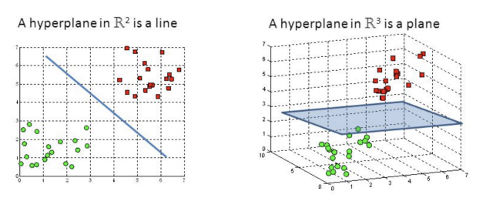
Hyperplane
Hyperplanes are decision boundaries that help classify the data points.
Data points falling on either side of the hyperplane can be attributed to different classes.
The dimension of the hyperplane depends upon the number of features.
If the number of input features is 2 (2D), then the hyperplane is just a line.
If the number of input features is 3 (3D), then the hyperplane becomes a two-dimensional plane.
It becomes difficult to imagine when the number of features exceeds 3.
Notes:
https://towardsdatascience.com/support-vector-machine-introduction-to-machine-learning-algorithms-934a444fca47
https://monkeylearn.com/blog/introduction-to-support-vector-machines-svm/

Slide 49




Support Vector Machines
 Find a linear hyperplane (decision boundary) that will separate the data

Slide 50
Support Vector Machines
B₁
One Possible Solution

Slide 51
Support Vector Machines
B₂
Another possible solution

Slide 52
Support Vector Machines
B₂
Other possible solutions

Slide 53
Support Vector Machines
B₁
B₂
 Which one is better? B1 or B2?
 How do you define better?

Slide 54
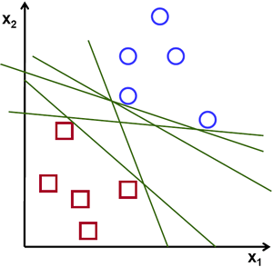

SVM: Hyperplane
To separate the two classes of data points, there are many possible hyperplanes that could be chosen.
The objective of the support vector machine algorithm is to find a hyperplane in an N-dimensional space (N — the number of features) that distinctly classifies the data points --> a plane that has the maximum margin (gap), i.e the maximum distance between data points of both classes.

Slide 55
SVM: Support vectors
Support vectors are data points that are closer to the hyperplane and influence the position and orientation of the hyperplane.
Using these support vectors, we maximize the margin of the classifier.
Deleting the support vectors will change the position of the hyperplane.
These are the points that help us build our SVM.

Slide 56
Support Vector Machines
B₁
margin
B₂
^{b}21 ^{b}22
^{b}11
^{b}12
Find hyperplane maximizes the margin => B1 is better than B2

Slide 57
Support Vector Machines
Find the hyperplane that optimizes both factors

Slide 58
Binary Classification
Tid | Refund | Marital Status | Taxable Income | Evade
1 | Yes | Single | 125K | No
2 | No | Married | 100K | No
3 | No | Single | 70K | No
4 | Yes | Married | 120K | No
5 | No | Divorced | 95K | Yes
6 | No | Married | 60K | No
7 | Yes | Divorced | 220K | No
8 | No | Single | 85K | Yes
9 | No | Married | 75K | No
10 | No | Single | 90K | Yes

Slide 59
Linear Separability

Slide 60
Large Margin Intuition
Maximum margin solution:
most stable under perturbations of the inputs

Slide 61
Large Margin Intuition
Maximizing the margin provides some reinforcement so that future data points can be classified with more confidence.
Margin: Reinforcement range of values
[-1,1]
We take the output of the linear function and if that output is greater than 1, we identify it with one class and if the output is -1, we identify is with another class.

Slide 62
Linear SVM
Linear model:
Learning the model is equivalent to determining the values of w and b
How to find w and b from training data?

Slide 63
Linear SVM
A linear classifier has the form
in 2D the discriminant is a line
w is the normal (perpendicular to gradient) to the line, and b the bias
w is known as the weight vector

Slide 64
Linear SVM
A linear classifier has the form
in 3D the discriminant is a plane, and in nD it is a hyperplane
Given linearly separable data x_{i} labelled into two categories y_{i} = {-1,1} , find a weight vector, w such that the discriminant function
separates the categories for i = 1, .., N
how can we find this separating hyperplane?

Slide 65
For example in 2D
Update the hyperplane (classifier linear function)
What is the best w?
if the data is linearly separable, then the algorithm will converge, convergence can be slow …separating line close to training data
we would prefer a larger margin for generalization

Slide 66
Linear SVM

Slide 67
Learning Linear SVM
Decision boundary depends only on support vectors
If you have data set with the same support vectors, decision boundary will not change
How to classify using SVM once w and b are found? Given a test record, x_{i}

Slide 68
SVM – Mathematical Derivation
What we know:
w . x⁺ + b = +1
w . x⁻ + b = -1
w . (x⁺ - x⁻) = 2

Slide 69
SVM – Optimization
Learning the SVM can be formulated as an optimization:

Slide 70
Support Vector Machines
What if the problem is not linearly separable?
In general there is a trade off between the margin and the number of errors on the training data

Slide 71
What if the problem is not linearly separable? Introduce slack variables

Slide 72
Slack variables: Soft Margin
Need to minimize:
Subject to:
If k is 1 or 2, this leads to same objective function as linear SVM but with different constraints.

Slide 73
SVM Applications
SVM has been used successfully in many real-world problems
text (and hypertext) categorization
image classification
bioinformatics (Protein classification, Cancer classification)
hand-written character recognition

Slide 74
Strength
Intuitive: The max-margin idea is among the most intuitive to understand.
Deal with outliers elegantly: The soft-margin variant of SVM allows tuning how much outliers affect the decision boundary.

Slide 75
Weakness
It is sensitive to noise
A relatively small number of mislabeled examples can dramatically decrease the performance
It only considers two classes
How to do multi-class classification with SVM?

Slide 76
Ensemble Methods

Slide 77
Ensembles
Old View
Learn one good model
New View
Learn a good set of models
Probably best example of interplay 相互作用 between “theory & practice” in Machine Learning
Naïve Bayes, k-NN, neural net, d-tree, SVM, etc
Notes:
An ensemble合奏 is a group of musicians, dancers, or actors who perform together

Slide 78
Rationale for Ensemble Learning
No Free Lunch: There is no algorithm that is always the most accurate
Generate a group of base-learners which when combined have higher accuracy (1 + 1 > 2)
Ensemble model improves accuracy and robustness over single model methods
Different learners use different
Algorithms
Parameters
Representations
Training sets
Subproblems

Slide 79
Ensemble Methods
Construct a set of classifiers from the training data
Predict class label of previously unseen records by aggregating predictions made by multiple classifiers

Slide 80
Ensemble
model 1
Ensemble model
Combine multiple models into one!
Data
model 2
……
model k
Applications: classification, clustering, collaborative filtering, anomaly detection……

Slide 81
General Idea

Slide 82
Ensemble Method Example: Netflix Prize
Supervised learning task
Training data is a set of users and ratings (1,2,3,4,5 stars) those users have given to movies.
Construct a classifier that given a user and an unrated movie, correctly classifies that movie as either 1, 2, 3, 4, or 5 stars
$1 million prize for a 10% improvement over Netflix’s current movie recommender
Competition
At first, single-model methods are developed, and performances are improved
However, improvements slowed down
Later, individuals and teams merged their results (ensemble), and significant improvements are observed
Notes:
https://en.wikipedia.org/wiki/Netflix_Prize
https://www.kaggle.com/netflix-inc/netflix-prize-data

Slide 83
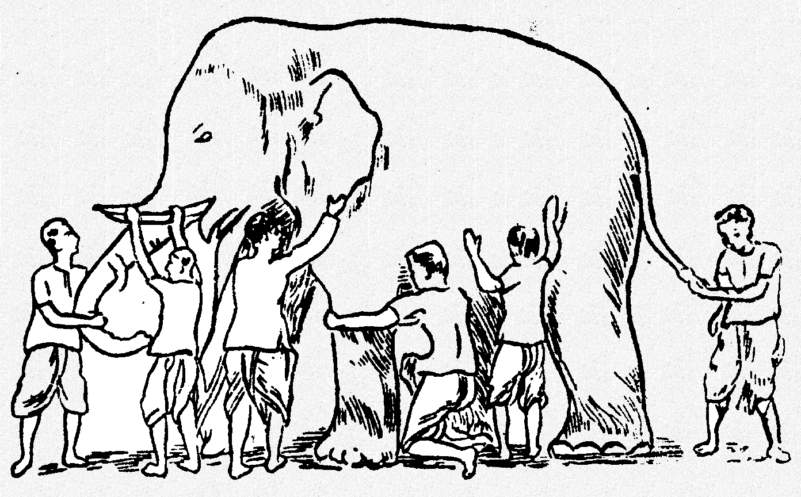
Why Ensemble Works? (1)
Ensemble gives the global picture!
Some unknown distribution
Model 1
Model 6
Model 3
Model 5
Model 2
Model 4

Slide 84
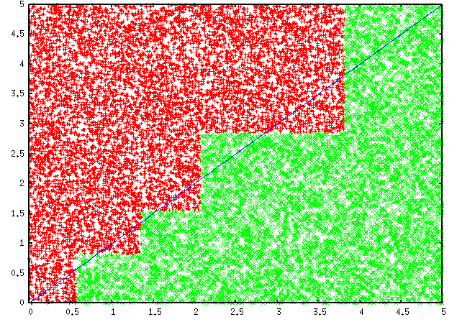
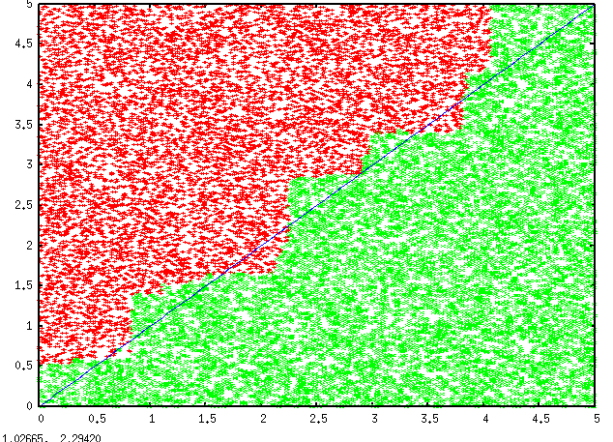
Why Ensemble Works? (2)
Overcome limitations of single hypothesis
The target function may not be implementable with individual classifiers, but may be approximated by model averaging
Decision Tree
Model Averaging

Slide 85
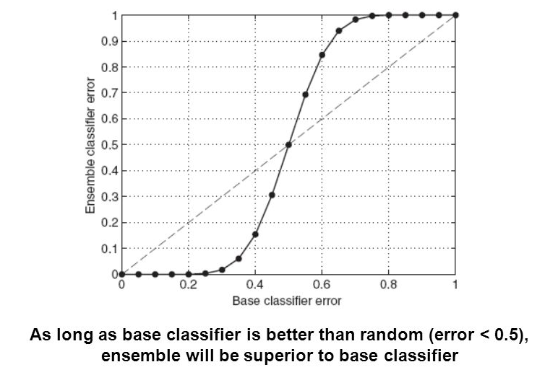
How to generate an ensemble of classifiers?
Suppose there are 25 base classifiers
Each classifier has error rate, Ꜫ= 0.35 (35%)
Assume classifiers are independent
Probability that the ensemble classifier makes a wrong prediction:

Slide 86
Types of Ensemble Methods
Manipulate data distribution
Example: bagging, boosting
Manipulate input features
Example: random forests
Manipulate class labels
Example: error-correcting output coding
Notes:
error-correcting output coding
http://www.cs.cmu.edu/~aberger/pdf/ecoc.pdf
https://towardsdatascience.com/the-random-forest-algorithm-d457d499ffcd

Slide 87
Bootstrap Method
A powerful statistical method for estimating a quantity from a data sample.
Let’s assume we have a sample of 100 values (x) and we’d like to get an estimate of the mean of the sample.
We know that our sample is small and that our mean has error in it (high variance).
We can improve the estimate of our mean using the bootstrap procedure:
Create many (e.g. 1000) random sub-samples of our dataset with replacement (meaning we can select the same value multiple times).
Calculate the mean of each sub-sample.
Calculate the average of all of our collected means and use that as our estimated mean for the data.

Slide 88
Bagging (Bootstrap AGgregating)
An ensemble meta-algorithm designed to improve the stability and accuracy of machine learning algorithms
Can be used in both regression (predict continuous value) and classification (predict nominal value)
Reduces variance and helps to avoid overfitting (increase generalization)
Usually applied to decision trees, though it can be used with any type of method

Slide 89
Bagging
Take M bootstrap samples with replacement (meaning we can select the same value multiple times)
Train M different classifiers on these bootstrap samples
For a new query, let all classifiers predict and take an average (or majority vote)
If the classifiers make independent errors, then their ensemble can improve performance (neutralize each other's error).
Stated differently:
the variance in the prediction is reduced (we do not suffer from the random errors that a single classifier is bound to make).

Slide 90
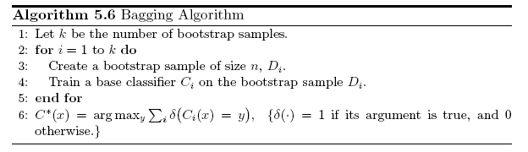
Bagging Algorithm

Slide 91
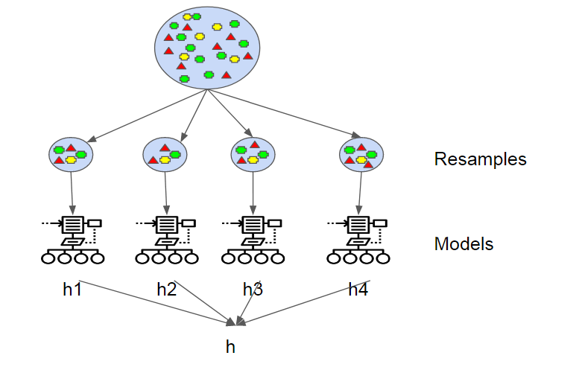
Bagging

Slide 92
Bagging Example
Consider 1-dimensional data set:
Classifier is a decision stump
Decision rule: x ≤ k versus x > k
Split point k is chosen based on entropy
x ≤ k
True
False
y_{left}
y_{right}
Notes:
https://en.wikipedia.org/wiki/Decision_stump
A decision stump is a machine learning model consisting of a one-level decision tree.

Slide 93
Bagging Example
Summary of Training sets:

Slide 94
Bagging Example
Assume test set is the same as the original data
Use majority vote to determine class of ensemble classifier

Slide 95
Most notable benefits
Surprisingly competitive performance & rarely overfits
Is capable of reducing variance of constituent models
Improves ability to ignore irrelevant features
error(x) = noise(x) + bias(x) + variance(x)
Variance: how much does prediction change if we change the training set?

Slide 96
Bagging Summary
Works well if the base classifiers are unstable (classifers complement each other)
A learning algorithm is unstable if small changes in the training data can produce large changes in the output hypothesis
Increased accuracy because it reduces the variance of the individual classifier
Does not focus on any particular instance of the training data
Therefore, less susceptible to model over-fitting when applied to noisy data

Slide 97
Boosting
Boosting is a general ensemble method that creates a strong classifier from a number of weak classifiers.
This is done by building a model from the training data, then creating a second model that attempts to correct the errors from the first model (in sequence).
Models are added until the training set is predicted perfectly or a maximum number of models are added.

Slide 98
Boosting
An iterative procedure to adaptively change distribution of training data by focusing more on previously misclassified records
Initially, all N records are assigned equal weights
Unlike bagging, weights may change at the end of each boosting round
Different implementations vary in terms of
how the weights of the training examples are updated, and
how the predictions are combined

Slide 99
Boosting Intuition
Equal weights are assigned to each training instance (1/N for round 1) at first round
After a classifier C_{i} is learned, the weights are adjusted to allow the subsequent classifier C_{i+1} to “pay more attention” to data that were misclassified by C_{i}.
Final boosted classifier C∗combines the votes of each individual classifier
Weight of each classifier’s vote is a function of its accuracy
Principles
Boost a set of weak learners / classifiers to a strong learner
Make records currently misclassified more important
Records that are wrongly classified will have their weights increased
Records that are classified correctly will have their weights decreased

Slide 100
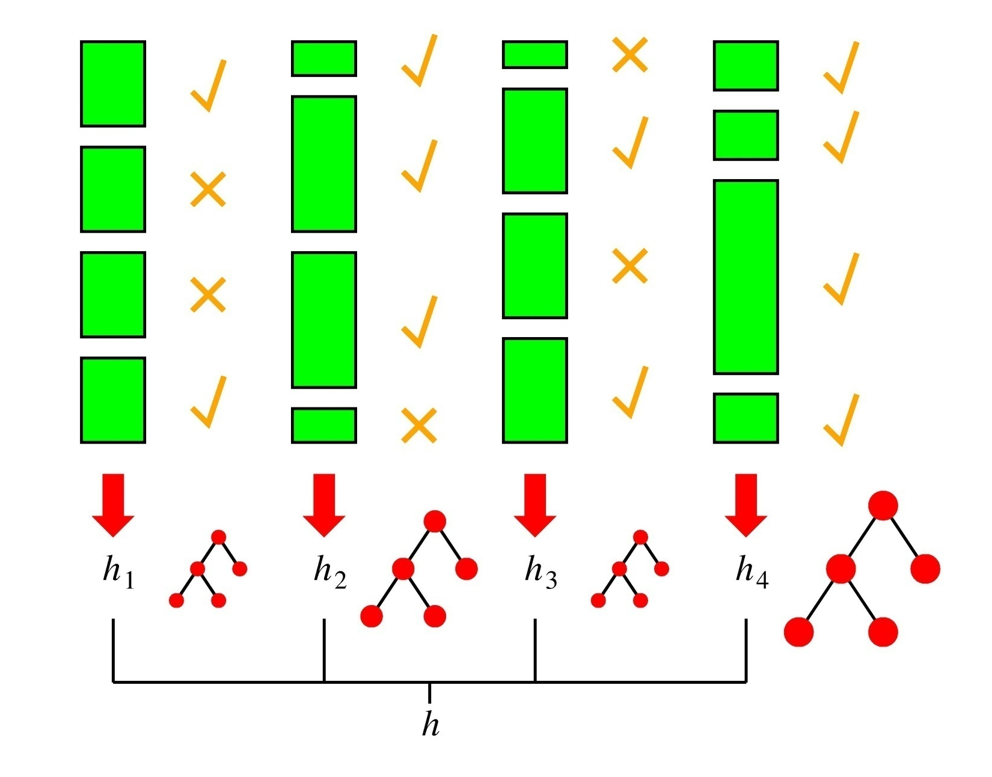
Boosting in a Picture
boosting rounds
training cases
Correctly
classified
This example
has a large weight
in this round
This DT has
a strong vote.

Slide 101
Adaboost (Adaptive Boost)
AdaBoost is a specific boosting method. AdaBoost is best used to boost the performance of decision trees on binary classification problems.
Input:
Training set D containing N instances
T rounds
A classification learning scheme
Output:
A composite model

Slide 102
Adaboost (Adaptive Boost)
Initially, set uniform weights (1/n) on all the records
At each round
Create a bootstrap sample based on the weights
Train a classifier on the sample and apply (test) it on the original training set
Records that are wrongly classified will have their weights increased
Records that are classified correctly will have their weights decreased
If the error rate is higher than 50% (random error), start over
Final prediction (binary class) is weighted average of all the classifiers with weight representing the training accuracy

Slide 103
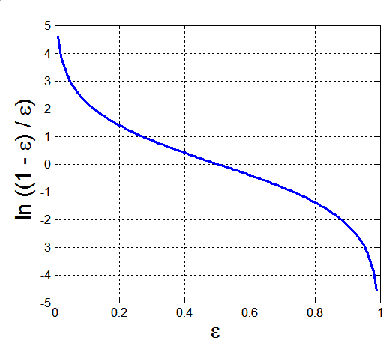
Example: AdaBoost
Notes:
https://en.wikipedia.org/wiki/AdaBoost

Slide 104
Example: AdaBoost
Weight update:
If any intermediate rounds produce error rate higher than 50% (random error), the weights are reverted back to 1/n and the resampling procedure is repeated.
Classification:

Slide 105
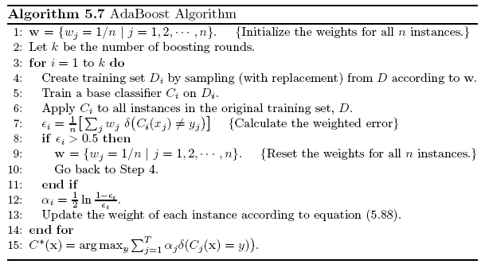
AdaBoost Algorithm

Slide 106
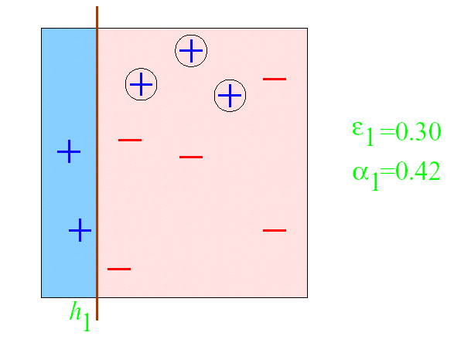
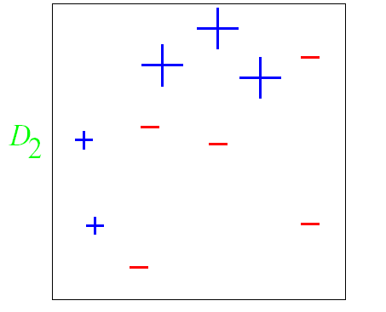
AdaBoost Example
ε = error rate of classifier
α = weight of classifier
ROUND 1

Slide 107
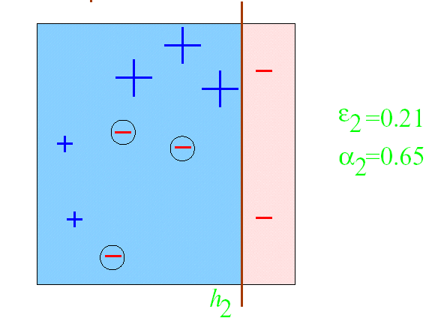
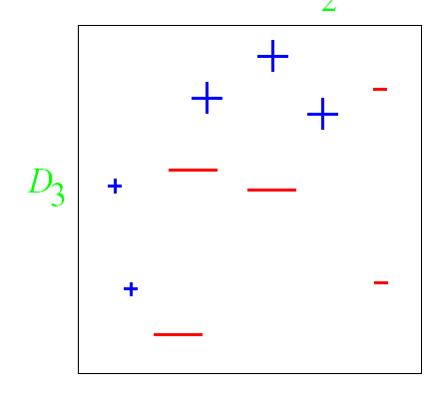
AdaBoost Example
ROUND 2

Slide 108
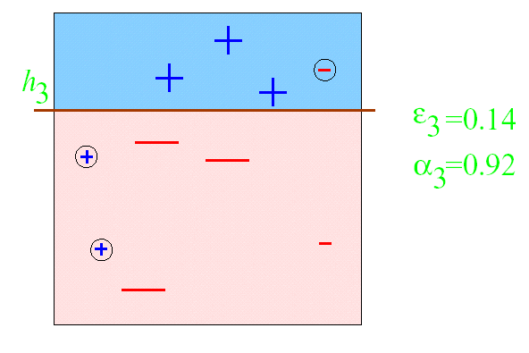
AdaBoost Example
ROUND 3

Slide 109
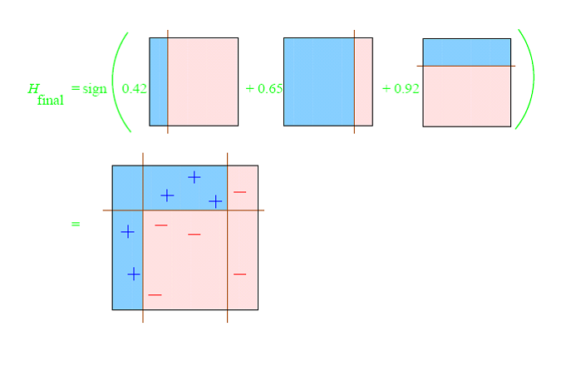
AdaBoost Example

Slide 110
AdaBoost Example

Slide 111
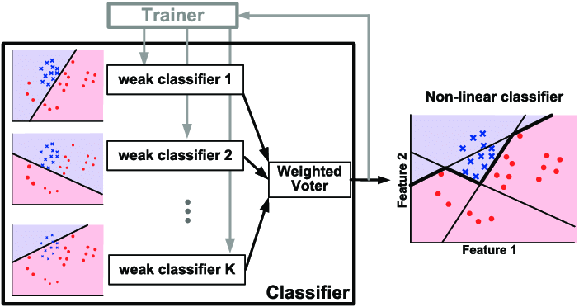
AdaBoost Example

Slide 112
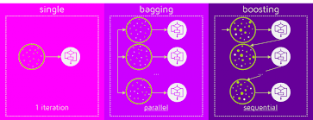
Bagging vs Boosting
Notes:
https://www.kdnuggets.com/2017/11/difference-bagging-boosting.html

Slide 113
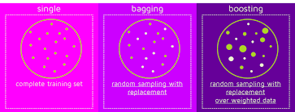
Bagging vs Boosting

Slide 114
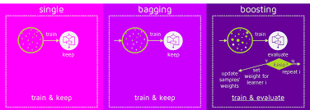
Bagging vs Boosting

Slide 115
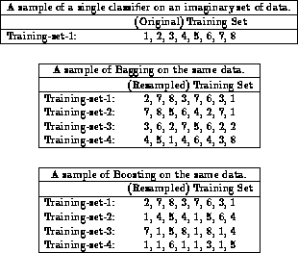
Bagging vs Boosting

Slide 116
Boosting Summary
Train classifiers (e.g. decision trees) in a sequence.
A new classifier should focus on those cases which were incorrectly classified in the last (previous) round.
Combine the classifiers by letting them vote on the final prediction (like bagging).
Each classifier is “weak” but the ensemble is “strong”.

Slide 117
Conclusion
Naïve Bayes makes equally important and independent features assumptions.
Given labeled training data (supervised learning), SVM outputs an optimal hyperplane which categorizes new examples.
Ensemble Methods:
Construct a set of classifiers from the training data
Predict class label of previously unseen records by aggregating predictions made by multiple classifiers

Slide 118
Main References
Harrington, P (2012). Machine Learning in Action. Manning Publications.
Richert, W. and Coelho, L.P. (2013). Building Machine Learning Systems with Python. Packt Publishing.
Witten, I.H, Franck, E, and Hall, M. A. (2011). Data Mining: Practical Machine Learning Tools and Techniques. (3rd ed.). Morgan Kaufmann.
Pang-Ning Tan, Michael Steinbach, Anuj Karpatne, Vipin Kumar (2018). Introduction to Data Mining (2nd Edition), Pearson

Slide 119
Other References
J. Grus (2015). Data Science from Scratch: First Principles with Python. O'Reilly Media.
C. C. Aggarwal. (2015). Data Mining: The Textbook. Springer
Richert, W. and Coelho, L.P. (2013). Building Machine Learning Systems with Python. Packt Publishing.
Russel M.A. (2013). Mining the Social Web: Data Mining Facebook, Twitter, LinkedIn, Google+, GitHub, and More. (2nd Ed). O’Reilly Media.

Slide 120
Online References
https://www.geeksforgeeks.org/naive-bayes-classifiers/
https://www.geeksforgeeks.org/classifying-data-using-support-vector-machinessvms-in-r/

